Slide 1
Decision Making
CJ 6340 Administration in CJ

Slide 2
Assigned Readings
Ch. 12 Decision Making SKK
  Overview of decision making in CJ organizations, including styles, politics, role of discretion and prediction, ethics, and key themes for improving CJ decision making
Article 21 “The science of ‘muddling through’” (Lindblom, 1959) Classics
  Describes and discusses the successive limited comparisons (branch) method for making policy and planning decisions
Article 30 “Dilemmas in a general theory of planning” (Rittel & Webber, 1973) Classics
  Addresses the limitations of scientific approaches (the root method) for solving “wicked problems” in social policy and lists characteristics of wicked problems

Slide 3
Learning Objectives
Ch. 12
Classics
Define decision making and describe different styles of decision making
Describe the impact of culture and politics on decision making
Recognize and describe the role of discretion and prediction in CJ
Discuss ways for improving decisions in CJ
Define and describe the branch method
Define and describe wicked problems

Slide 4
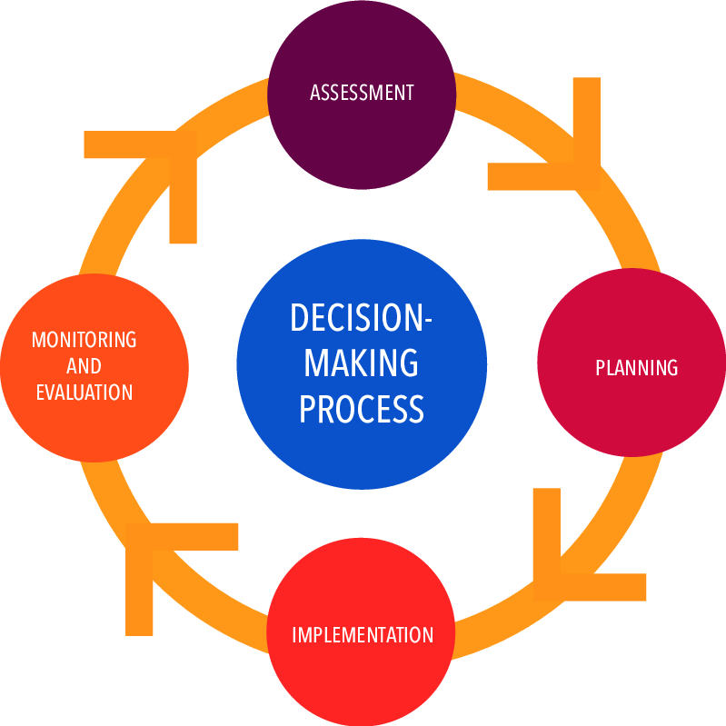
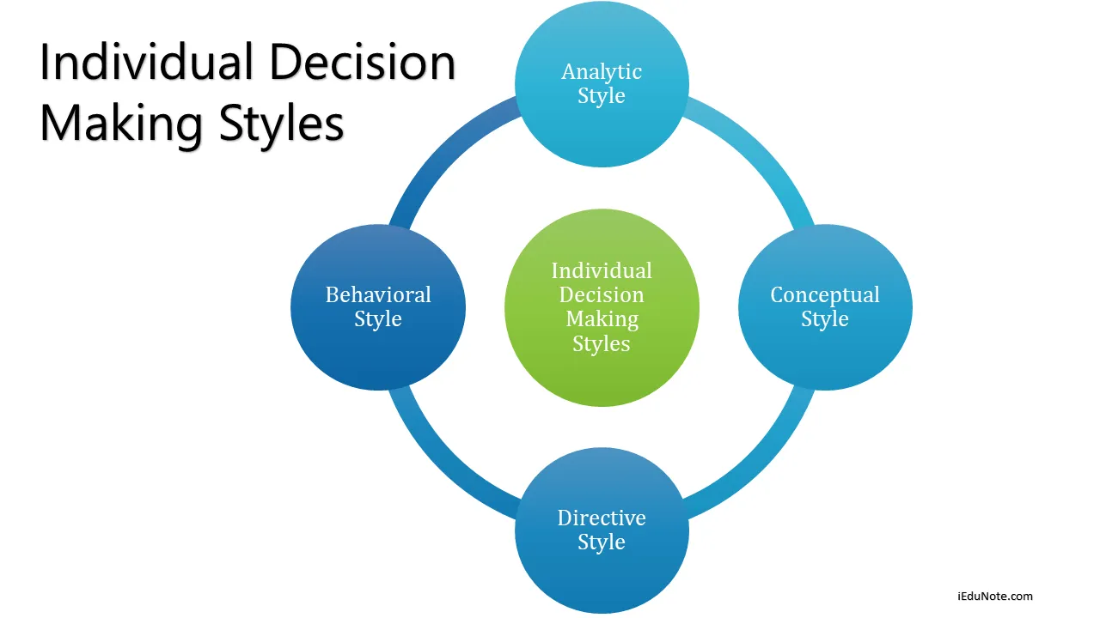
Decision Making

Slide 5
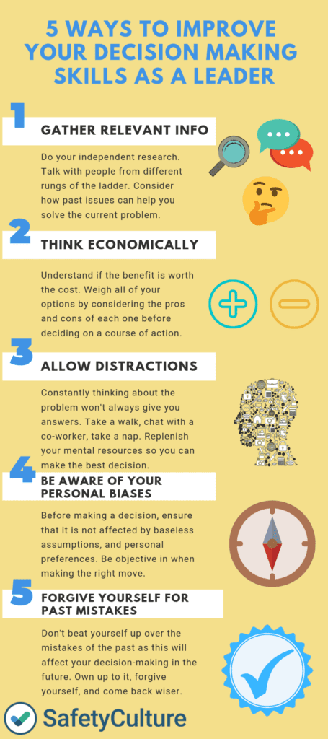
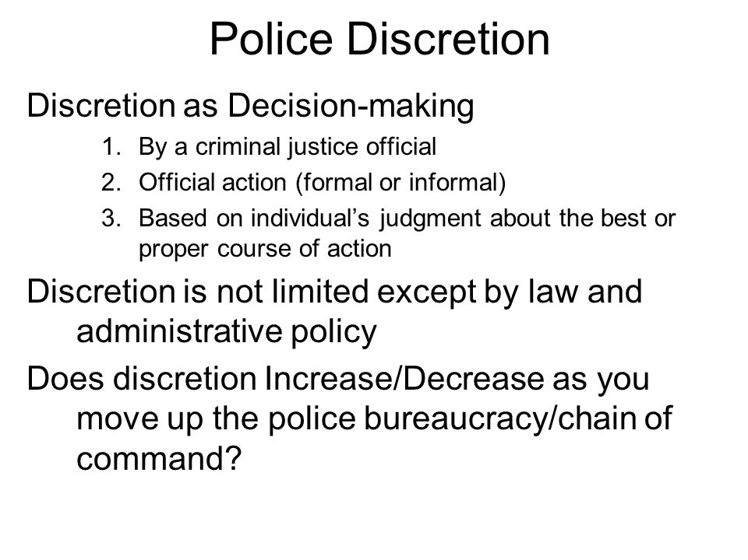

Slide 6
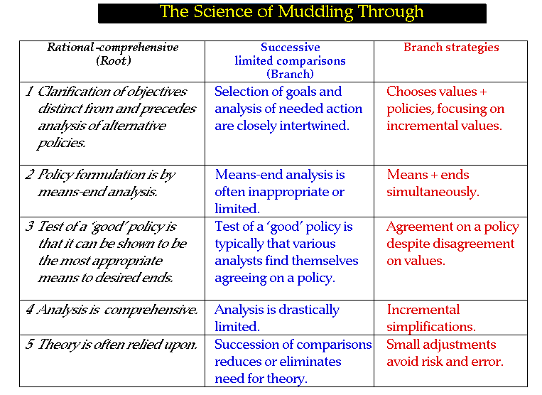

Slide 7
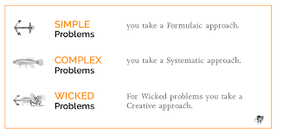
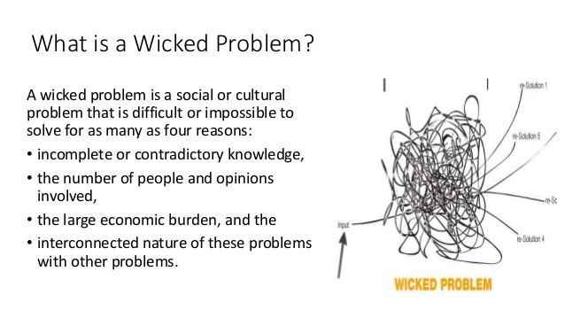

Slide 8
Essay: Your Decisions
Analyze decision making in your job and in your agency

